Slide 1
Make the switch to Lync 2013
In the message bar, click Enable Editing,
then press F5 to start the course.

Slide 2
Make the switch to Lync 2013
Closed captions
Press F5 to start, Esc to stop
1/5 videos
1:05
0:40
1:05
1:11
0:48
Add Contacts
Make Calls
Check Availability
Share Desktop
Change Picture
Summary
Feedback
Help

Slide 3
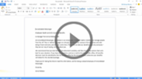
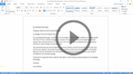
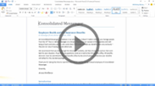
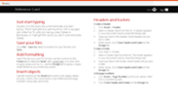
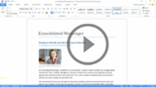
Make the switch to Lync 2013
Closed captions
Press F5 to start, Esc to stop
2/5 videos
1:05
0:40
1:05
1:11
0:48
Add Contacts
Make Calls
Check Availability
Share Desktop
Change Picture
Summary
Feedback
Help

Slide 4
Make the switch to Lync 2013
Closed captions
Press F5 to start, Esc to stop
3/5 videos
1:05
0:40
1:05
1:11
0:48
Add Contacts
Make Calls
Check Availability
Share Desktop
Change Picture
Summary
Feedback
Help

Slide 5
Make the switch to Lync 2013
Closed captions
Press F5 to start, Esc to stop
4/5 videos
1:05
0:40
1:05
1:11
0:48
Add Contacts
Make Calls
Check Availability
Share Desktop
Change Picture
Summary
Feedback
Help

Slide 6
Make the switch to Lync 2013
Closed captions
Press F5 to start, Esc to stop
5/5 videos
1:05
0:40
1:05
1:11
0:48
Add Contacts
Make Calls
Check Availability
Share Desktop
Change Picture
Summary
Feedback
Help

Slide 7
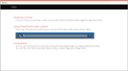
Help
Course summary—Make the switch to Lync 2013
Course summary
Find and add contacts (1:05)
This video shows you five ways to quickly build your Contact list in Lync 2013.
Make a call (0:40)
Making a call in Lync 2013 is easer with the Quick Lync menu.
Check someone’s availability (1:05)
This video takes you beyond presence indicators, showing you how to check someone’s schedule, and even tag them –all without leaving Lync.
Share your desktop (1:11)
You don’t need to be in a meeting to share your desktop – you can do so from a simple instant message.
Change your picture (0:48)
The picture you display in Lync 2013 can be any size and in any location.
See also
More training courses
Office Compatibility Pack
Press F5 to start, Esc to stop
1
2
3
4
5
6
7
8
1:05
0:40
1:05
1:11
0:48
Add Contacts
Make Calls
Check Availability
Share Desktop
Change Picture
Summary
Feedback
Help

Slide 8
Help
Rating and comments
Course summary
How did we do? Please tell us what you think
Thank you for viewing this course!
Check out more courses
Press F5 to start, Esc to stop
1
2
3
4
5
6
7
8
1:05
0:40
1:05
1:11
0:48
Add Contacts
Make Calls
Check Availability
Share Desktop
Change Picture
Summary
Feedback
Help

Slide 9
Help
Help
Course summary
Using PowerPoint’s video controls
Point at the bottom edge of any video to start, stop, pause, or rewind. You drag to rewind.
Stopping a course
If you’re viewing online, click your browser’s Back button. If you’re viewing offline, press Esc. If you’re watching a video, press Esc once to stop the video, again to stop the course.
Going places
You can go to any part of a course by clicking the thumbnails (light or shaded) below the video. You can also click the forward and back arrows, or press Page Up or Page Down.
If you download a course and the videos don’t play
Click Enable Editing if you see that button. If that doesn’t work, you probably have PowerPoint 2007 or earlier, so you need to get the PowerPoint Viewer.
Press F5 to start, Esc to stop
1
2
3
4
5
6
7
8
1:05
0:40
1:05
1:11
0:48
Add Contacts
Make Calls
Check Availability
Share Desktop
Change Picture
Summary
Feedback
Help

