Slide 1
Work with word counts in your document
In the message bar, click Enable Editing,
then press F5 or click Slide Show > From Beginning to start the course.
If the videos in this course don’t play, you may need to download QuickTime or just switch to PowerPoint 2013.
j

Slide 2
Work with word counts in your document
Closed captions
I’m working on a Word document for a school assignment, and I don’t need to write more than 1,000 words.
Luckily, Word 2013 provides a few handy word counting features that will help me keep below my word limit.
As I work on my document, I can keep an eye on my word count on the status bar down in the lower left corner of the Word window.
If you don’t see the word count in your document,
right-click anywhere on the status bar to bring up this menu, and then click Word Count.
As I type or remove text in my document, the Word Count updates automatically.
And if I click on the word count in the status bar, a box appears giving me even more detail,
including the number of characters and the number of lines that my document contains.
I don’t want to include my document’s many footnotes in my total word count, so I’ll uncheck this box.
This section of my document can’t be more than a third of the total document length.
To check the length, I select the paragraphs in this section
and the status bar shows the number of words in my selected text.
It looks like I have 205 words in my selected text, out of a total of 968 words, so I’m still below my target.
I want to insert the word count in my document so my teacher can see it when I hand in my paper.
I click in my document where I want the word count to appear.
In the ribbon, on the Insert tab, I click Quick Parts, and then click Field.
I select NumWords in the list of Field names, and then click OK.
If I make changes to the document, the word count I inserted won’t update automatically.
To update it I’ll need to right-click the word count, and choose Update Field.
To make sure that the latest word count appears when I print my document,
I click File and then Options.
In the left panel, I click Display, and then under Printing options, I select Update fields before printing.
For more information about word counts, see the course summary.
Press F5 to start, Esc to stop
1/1 videos
2:37
Word counts
Summary
Feedback
Help

Slide 3
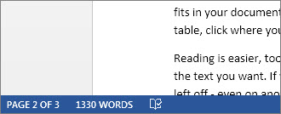
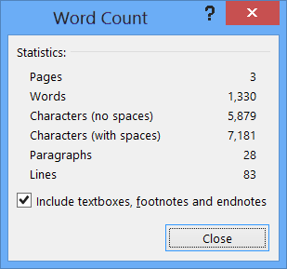
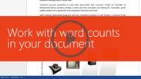
Help
Course summary—Work with word counts in your document
Course summary
Show the word count
To see the number of words in your document, look at the status bar at the lower left bottom of the Word window.
Find word count statistics
Click on the word count in the status bar to see the number of characters, lines, and paragraphs in your document.
Insert the word count in your document
Click in your document where you want the word count to appear.
Click Insert > Quick Parts > Field.
In the Field names list, click NumWords, and then click OK.
To update the word count, right-click the number, and then choose Update Field.
See also
Insert the word count in your document
Show the word count (and more)
More training courses
Office Compatibility Pack
Press F5 to start, Esc to stop
1
2
3
4
2:37
Word counts
Summary
Feedback
Help

Slide 4
Help
Rating and comments
Course summary
How did we do? Please tell us what you think
Thank you for viewing this course!
Check out more courses
Press F5 to start, Esc to stop
1
2
3
4
2:37
Word counts
Summary
Feedback
Help

Slide 5
Help
Help
Course summary
Using PowerPoint’s video controls
Point at the bottom edge of any video to start, stop, pause, or rewind. You drag to rewind.
Stopping a course
If you’re viewing online, click your browser’s Back button. If you’re viewing offline, press Esc. If you’re watching a video, press Esc once to stop the video, again to stop the course.
Going places
You can go to any part of a course by clicking the thumbnails (light or shaded) below the video. You can also click the forward and back arrows, or press Page Up or Page Down.
If you download a course and the videos don’t play
Click Enable Editing if you see that button. If that doesn’t work, you may have PowerPoint 2007 or earlier. If you do, you need to get the PowerPoint Viewer. If you have PowerPoint 2010, you need the QuickTime player, or you can upgrade to PowerPoint 2013.
Press F5 to start, Esc to stop
1
2
3
4
2:37
Word counts
Summary
Feedback
Help

