Slide 1
Batch File Basics
Automate repetitive computer processes
Friday, March 12, 2014
Presented by Thomas Redd,
STS, Granite School District

Slide 2
Why Create a Batch File?
Multiple commands
Executed in order
Several tasks accomplished in a batch
Launch multiple operations quickly and easily
Why not?

Slide 3
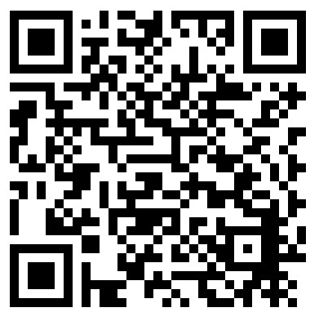
Getting Instructions
Download Document file of complete instructions here. http://41eq.qr.ai

Slide 4
Creating the Batch File
Programs you will need
NotePad
Command Window
Understanding of basic computer commands
Most DOS commands are available
Help with syntax is available in the Command Window

Slide 5
Getting organized
Know what you need to accomplish
Decide in which order to do your tasks
Create a folder of needed installers and icons
Locate this folder in an easily accessible location
Should it be on the shared drive?
Should it be in your personal documents?
Should it be on a portable drive?

Slide 6
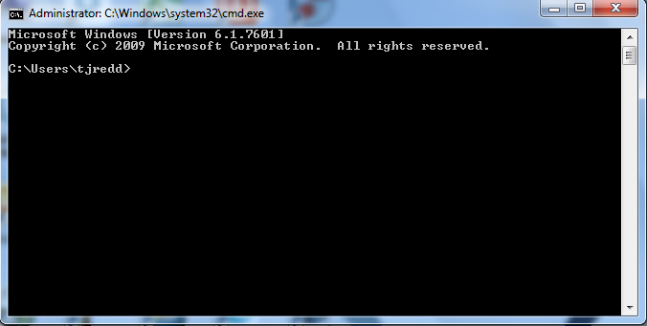
Getting Started Opening the Command Window
Click the Start button
Type “CMD”
Press Enter
The Command Box appears

Slide 7
Getting Started Opening NotePad
Click the Start button
Click All Programs
Click Accessories
Click NotePad
NotePad will open.

Slide 8
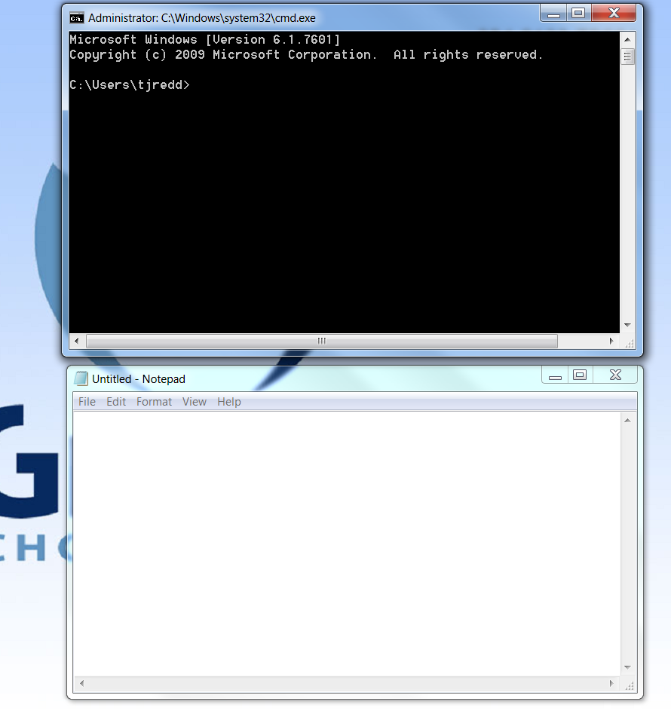
Getting Started
Position both boxes conveniently on your screen

Slide 9
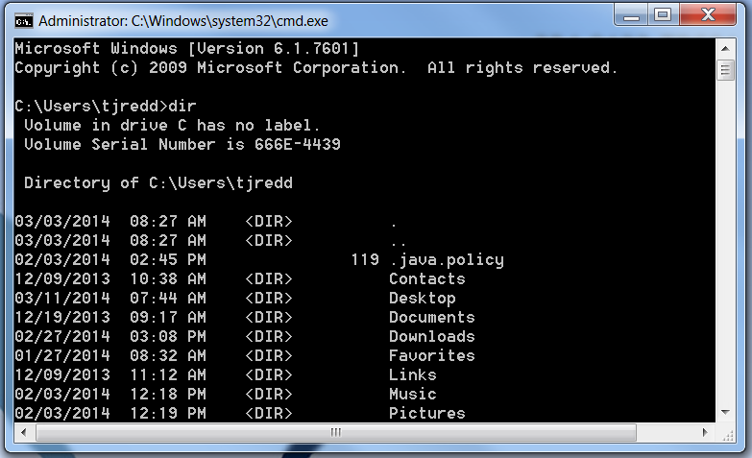
Getting Started
Test commands in the Command box

Slide 10
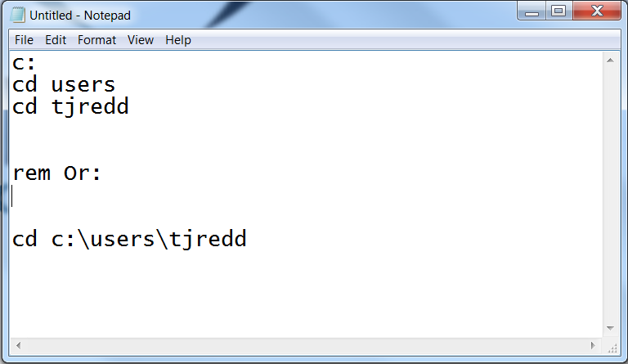
Getting Started
Compile a list of instructions in NotePad
One command per line

Slide 11
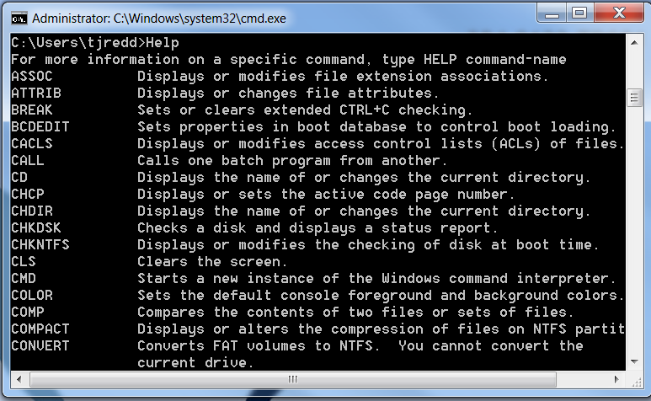
Getting Help with Commands
At the prompt, type “Help” and Enter for a list of commands

Slide 12
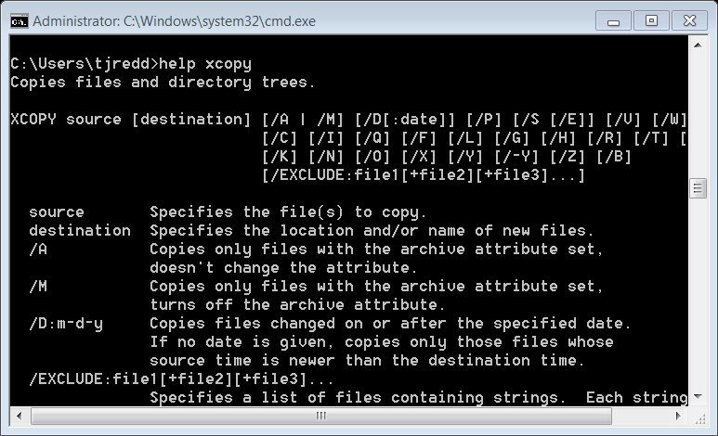
Specific Command Help
For more information on a specific command, type HELP (command-name)

Slide 13
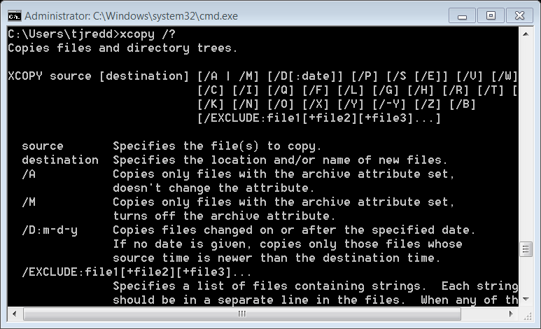
Specific Command Help
Or you could type the command and “ /?”
Example: xcopy /?

Slide 14
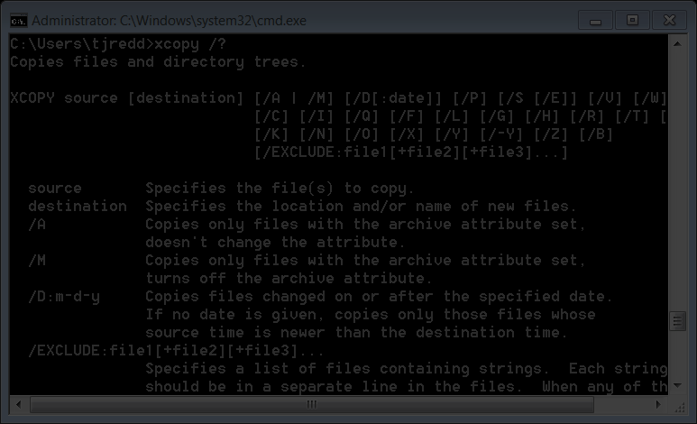
Command Syntax
Command
Locations for command operation
Required or optional control switches that
Control the command operation

Slide 15
Locations for operation
Required or optional control switches that
Control the command operation
Command
Additional Control Switch Instructions

Slide 16
Sample Batch File
S:
Cd\
Cd Valley_Crest
Cd tjredd
Dir
Dir > listfiles.txt
Xcopy *.* f:\home /e/s/d/y
Changes to the S Drive
Changes to the root directory
Changes to Valley Crest Directory
Changes to the tjredd sub-directory
Copies all files in the directory to a folder of an external drive (f:) in a folder called home—Over writing previous files, and including all new Changes.
Lists a directory of files on the screen
Writes a list of files in this folder to a file called listfiles in this folder

Slide 17
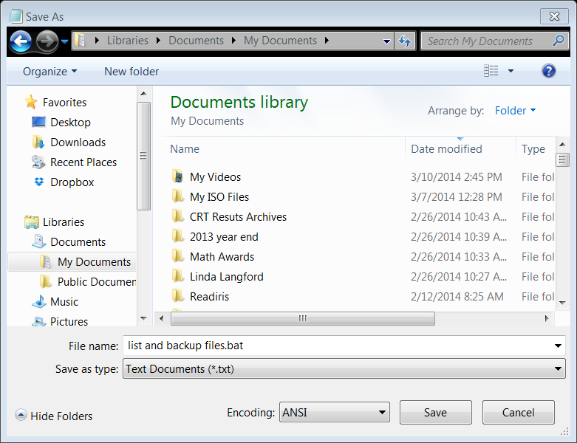
Saving Your Batch File
Save your NotePad file with a “.bat” ending
Save it to the folder you want it in

Slide 18
Using your Batch File
Navigate to your file location
Double click the batch file
When the black box goes away, the tasks have been completed

Slide 19
My Student Icon install batch
Create the Imagine Learning English Icon on the desktop
Go to the S Drive
Many Icons placed of the desktop of all users
s:
Cd\Valley_Crest\toms-icons-windows-7\icons-windows-7
ValleyCrestILE.msi
copy Windows*Live*Movie*Maker.* c:\Users\Public\Desktop /d/y
copy Valley*Crest*Elementary.* c:\Users\Public\Desktop /d/y
copy Student*Help*Files.* c:\Users\Public\Desktop /d/y
copy Road*to*Success.* c:\Users\Public\Desktop /d/y
copy Microsoft*Excel*2010.* c:\Users\Public\Desktop /d/y
copy Microsoft*PowerPoint*2010.* c:\Users\Public\Desktop /d/y
copy Microsoft*Publisher*2010.* c:\Users\Public\Desktop /d/y
copy Microsoft*Word*2010.* c:\Users\Public\Desktop /d/y
copy Go*Math*7.* c:\Users\Public\Desktop /d/y
copy SongsmithSetupAcademic.msi c:\*.*
cd MuseScore*Program
Note that the “*” is a wild card . In this file, it represents a space as well as the “Lnk” file ending
Change to the correct folder
Change to directory containing install files
Copy the Songsmith Program to the C drive

Slide 20
My Student Icon install batch (continued)
Change to another directory containing Install files
MuseScore-1.3.exe
copy FluidR3_FM.sf2 C:\Program*Files*(x86)\MuseScore\sound
Cd S:\Valley_Crest\Maintenance\toms-Icons-Windows-7\ilesetup
Pstory.msi
MicrosoftAutoCollageAcademicSetup.msi
Cd\s:\NE-STS_Shared\LanSchool_v7.7.4.18\Windows
Student.msi
pause
cd\Valley_Crest\toms-icons-windows-7\icons-windows-7
pause
atubecatcher.exe
Change to S Drive NE-STS Shared folder, the LanSchool install directory
Install MuseScore, a Music Notation program
Install Photo Story 3 for Windows
Install Microsoft AutoCollage
A Pause is required to make LanSchool install correctly. The message “Press any key to continue” appears in the command box when the install is complete
Install Student LanSchool Program
Change to another folder of install files
Copy improved sound files to MuseScore sound directory
Installs aTube Catcher.
This is the last command to run.
After installing, the Command Box will close showing that the install process is complete
Another pause before installing is required to make aTube Catcher install correctly

Slide 21
Where are my Files?
My files are stored in a hidden folder on the school shared drive

Slide 22
Store files where?
Create a folder that will have proper access
Hidden file?
Student access?
Teacher access?
In your personal document folder?
Copy install files to that folder
Create wanted desktop icons
Copy icons to that folder
Copy any wanted files (text or other) to that folder

Slide 23
Preparing a Computer
Re-image a machine
Log in
Navigate to your batch file
Double click the batch file
Watch the work be done for you quickly and completely with no human error or omissions
Batch files can be activated with LanSchool
All machines are identical
Smile and log off

Slide 24
This is what my completed computer desktop will look like after running the batch file

Slide 25
Getting Instructions
Download document file of complete instructions here. http://41eq.qr.ai or
QR code:
Link Valid until
April 1, 2014
Also Posted on
Tomshelppages.weebly.com

