Slide 1
Emedia Training
Created October 13, 2009
By Thomas Redd

Slide 2
What is ?
A large collection of videos and other media for educational purposes
A service of Utah Education Network in partnership with:
Tools to enhance your lessons
Great resource for Interconnections

Slide 3
Required Computer Settings
Internet Explorer Settings
Resolution 1024x768 (or higher)
Security Settings
Custom
Enable Automatic prompting for Downloads

Slide 4
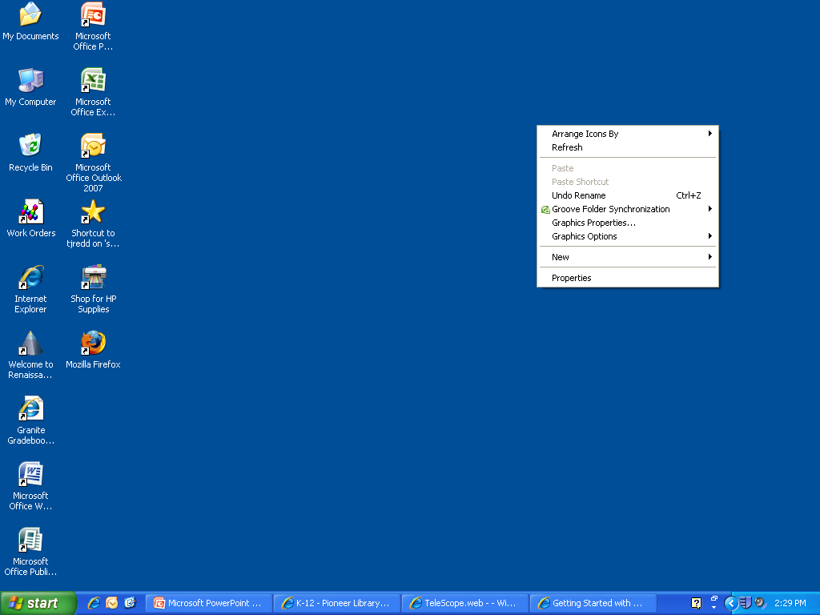
Changing Your Screen Resolution (Windows XP)
Right Click your Computer desktop—(Do not click on an Icon)

Slide 5
Changing Your Screen Resolution (Windows XP)
Click Properties

Slide 6
Changing Your Screen Resolution (Windows XP)
Go to the Settings tab

Slide 7
Changing Your Screen Resolution (Windows XP)
Move the resolution slider until it shows 1024x768 (or higher)
Use the OK button to apply the change

Slide 8
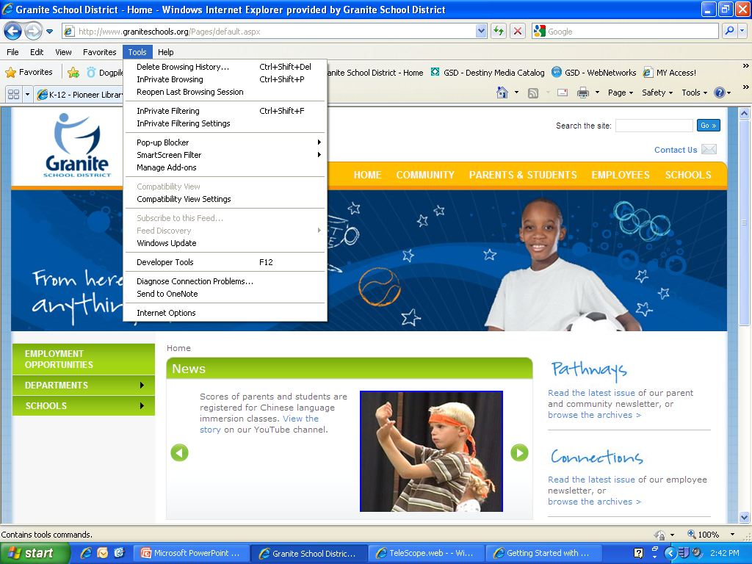
Enabling File Downloads from Internet Explorer
In Internet Explorer, Click the Tools menu and then choose Internet Options

Slide 9
Enabling File Downloads from Internet Explorer
Go to the Security tab

Slide 10
Enabling File Downloads from Internet Explorer
Select the Internet (globe icon)

Slide 11
Enabling File Downloads from Internet Explorer
Click the Custom Level button

Slide 12
Enabling File Downloads from Internet Explorer
Scroll down to the “Automatic Prompting for file downloads” item
Select the Enable option

Slide 13
Enabling File Downloads from Internet Explorer
Use the OK button to apply the change

Slide 14
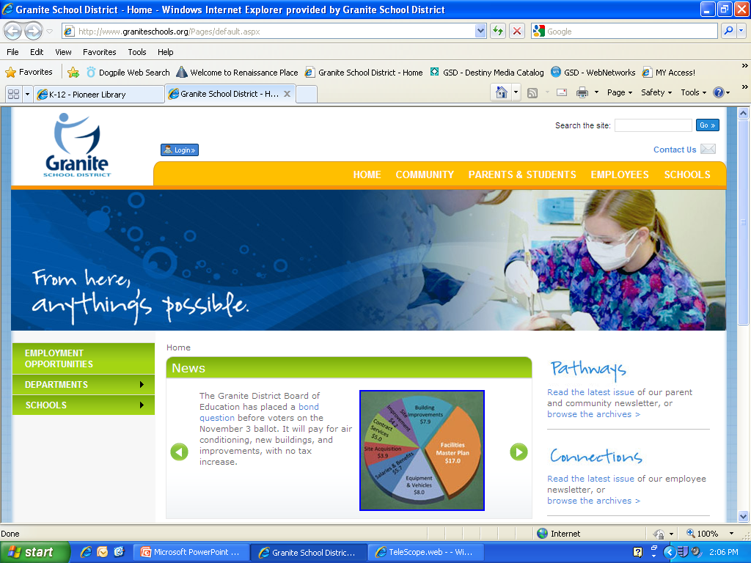
How to Find
Open Internet Explorer

Slide 15
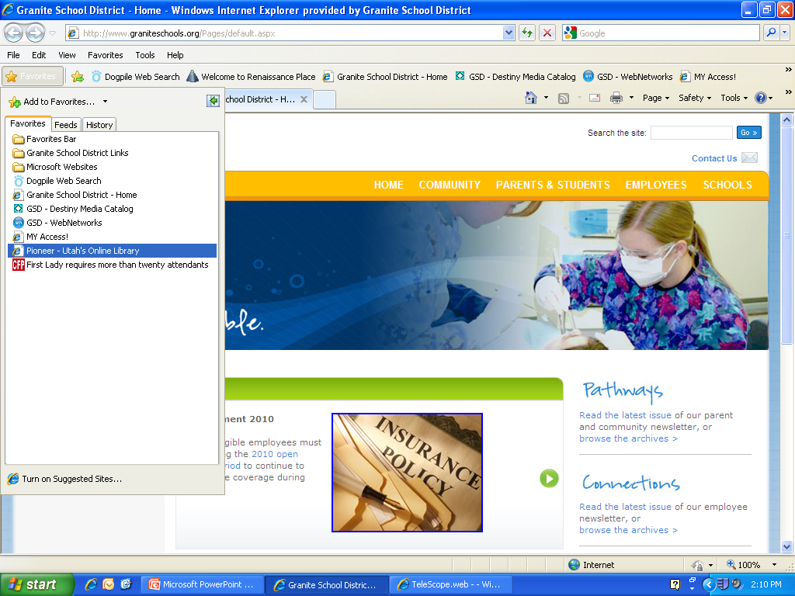
Click Favorites

Slide 16
Click Pioneer – Utah’s Online Library

Slide 17
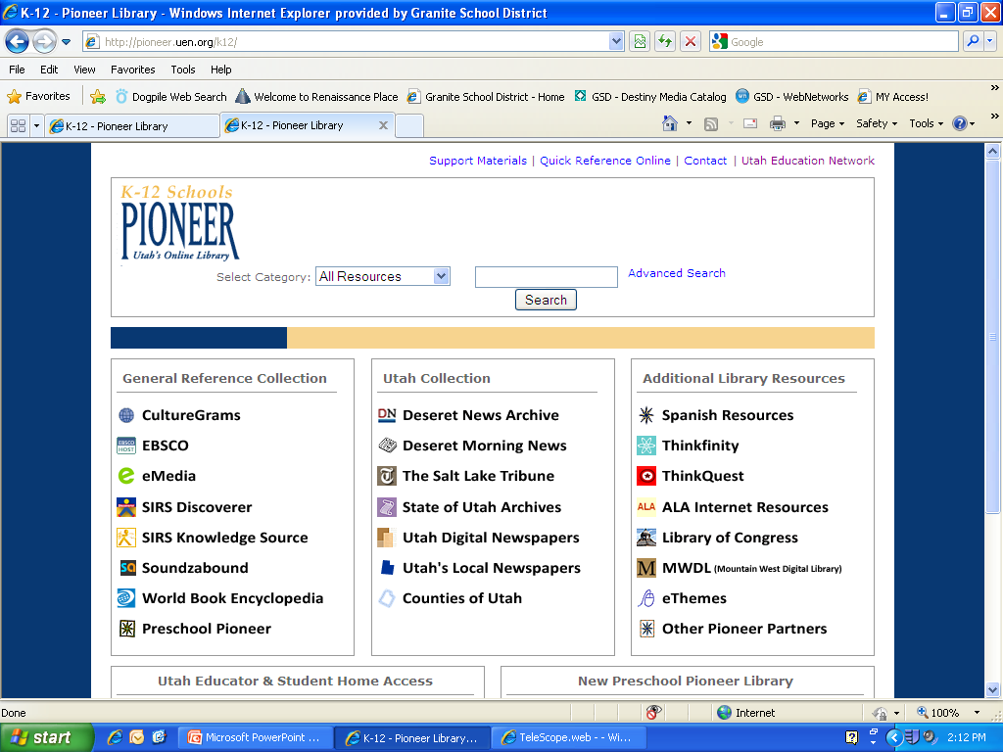
Click eMedia

Slide 18
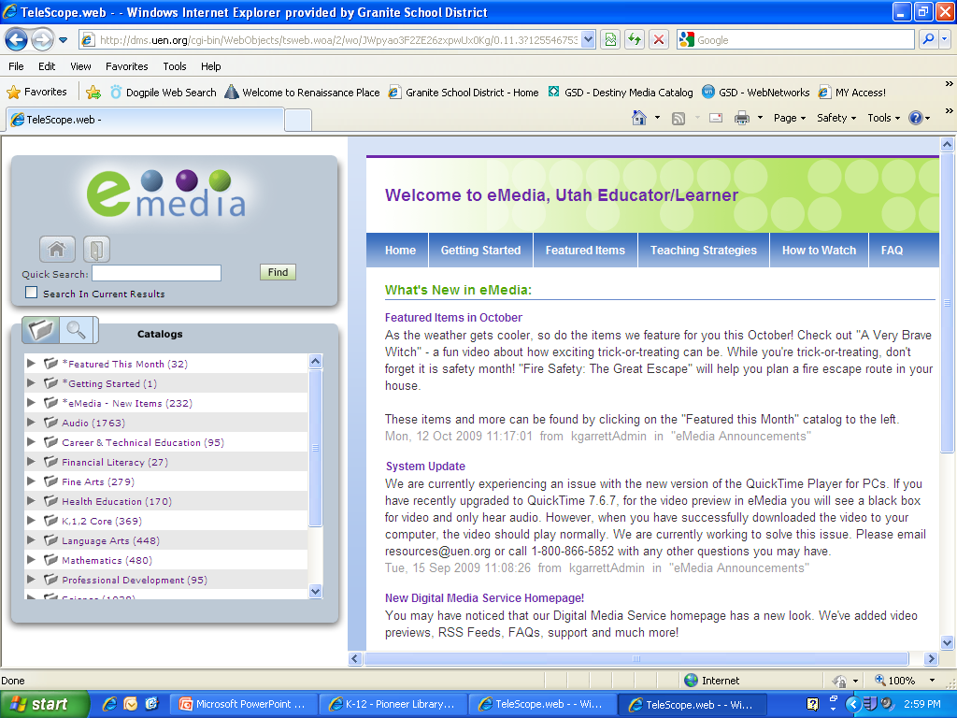
Enter your search word here
Click Find

Slide 19
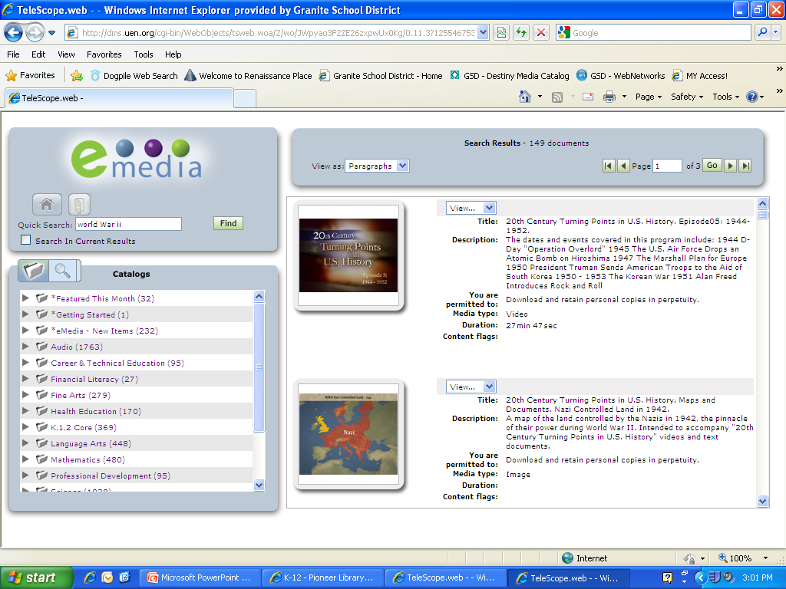
The right of the screen will display the media files that were found on your topic.
Scroll through items to find what you want.

Slide 20
Click View to either preview the item or see Information on the item, and start downloading the file.

Slide 21
Download
When prompted to save a file, locate or create a folder on your computer in which to save it
Keep like subjects together in sub directory
If you save to My Documents, you will be saving to your M Drive, and could fill it quickly
Files in your M Drive are backed up daily
Other files need to be backed up locally—to another drive or location

Slide 22
Use the Download Now button to download the file.

Slide 23
Downloads
You may choose either the Quick Time or Win Media file format
I prefer Win Media files because Windows includes the viewer for these files
QuickTime must be downloaded and installed before using QuickTime files

Slide 24
Click Save
Give save location and click save again
Or
Click Open to view file without saving it.

Slide 25
Save Location
Use this icon to create a new folder
Or
Move up a level with this icon
Or
Locate your folder here

Slide 26
Remember
Search
Preview
Download to your computer and save to:
My Documents
A folder you create
A portable hard drive
Thousands of media files are available on almost every topic.
Use them wisely and have fun!

Slide 27
Questions?

Slide 28
For More Help
Contact Mr. Redd
Office Phone: 385 646-1530
Email: tjredd@graniteschools.org
Find me in the school
My schedule is on my office door
Cell Phone: 385-646-2341
Place a note in my mailbox

