Slide 1
Plickers
A cost effective classroom set of Clickers

Slide 2
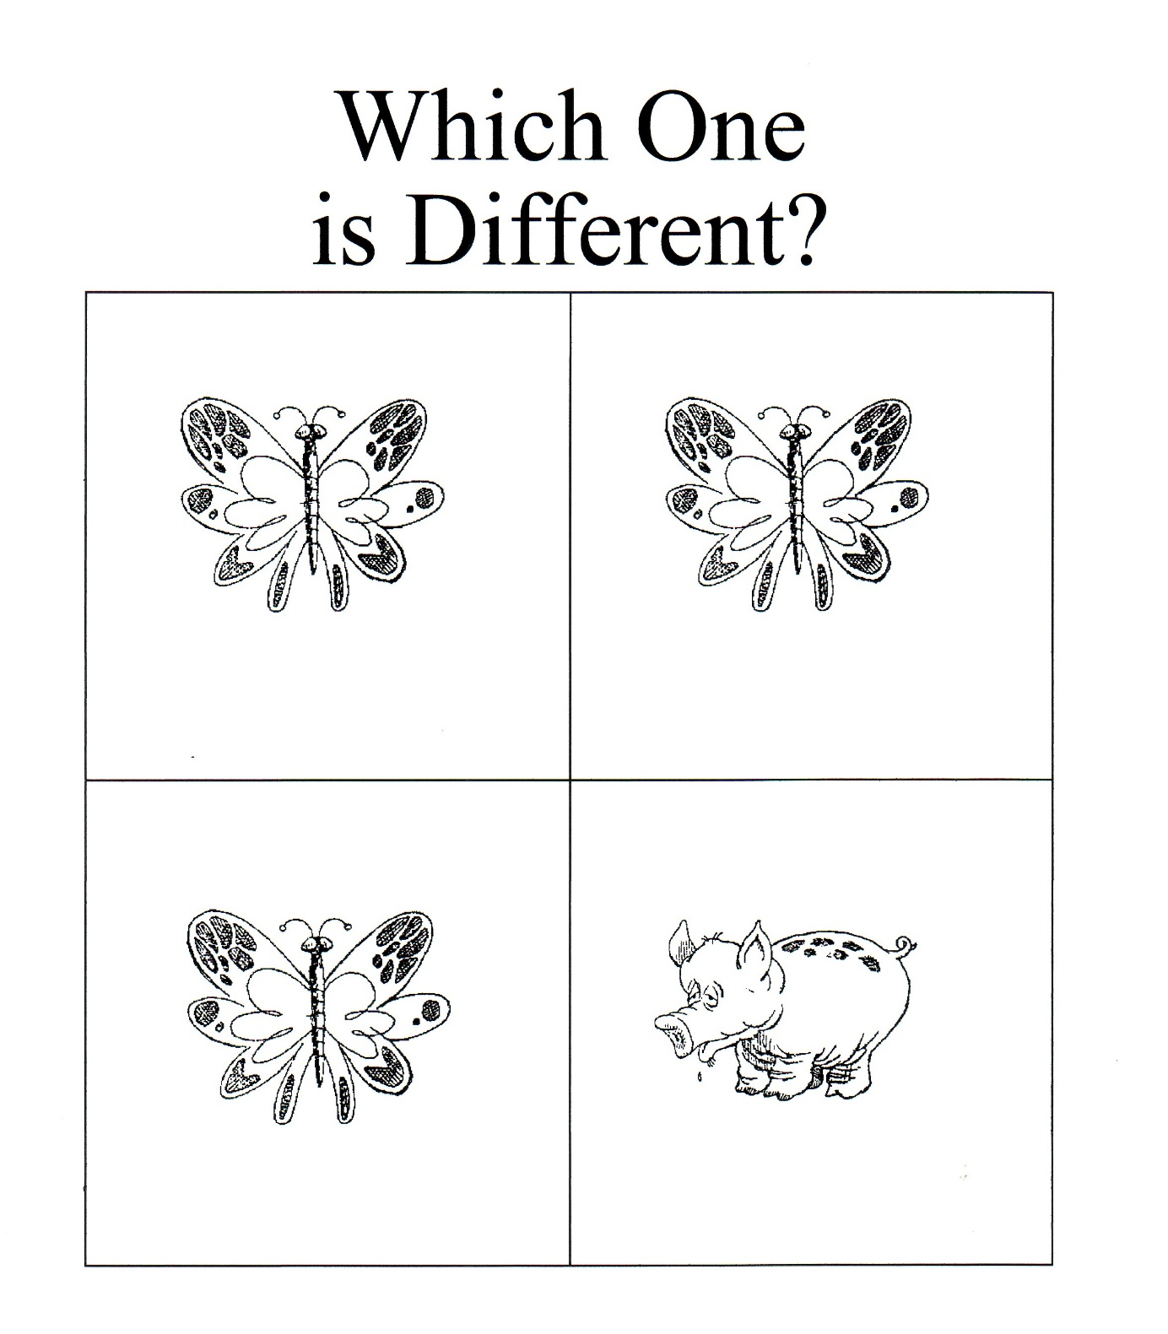
A
B
C
D

Slide 3
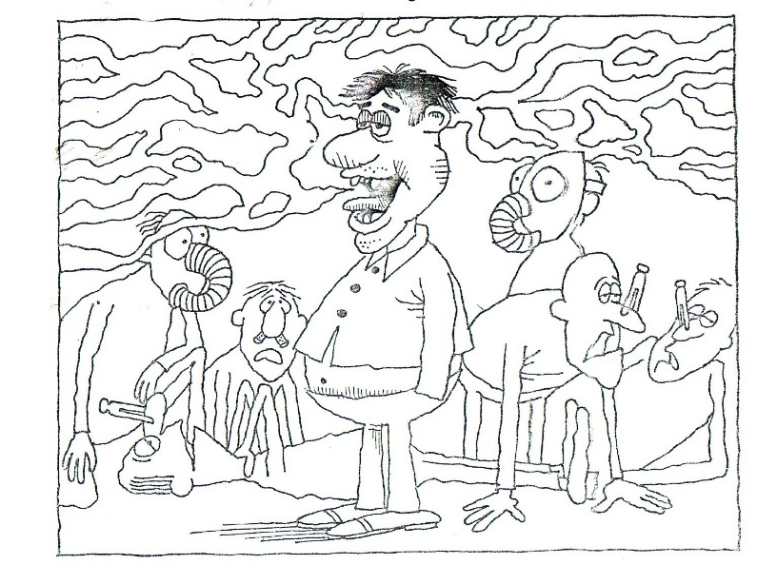
A B C D
Find the Man with the Bad Breath.
One of the people in the picture below has bad breath. Can you find him?

Slide 4
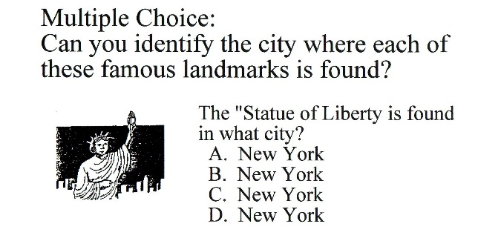
The Landmark Quiz

Slide 5
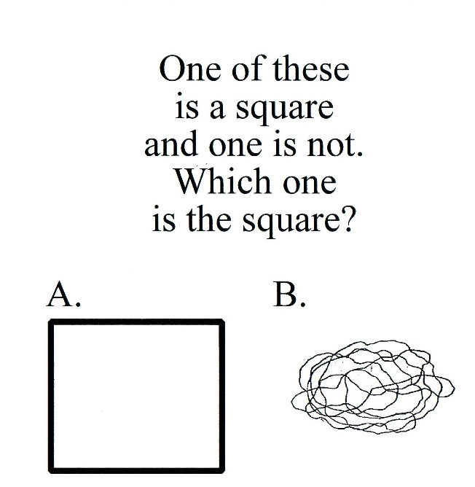

Slide 6
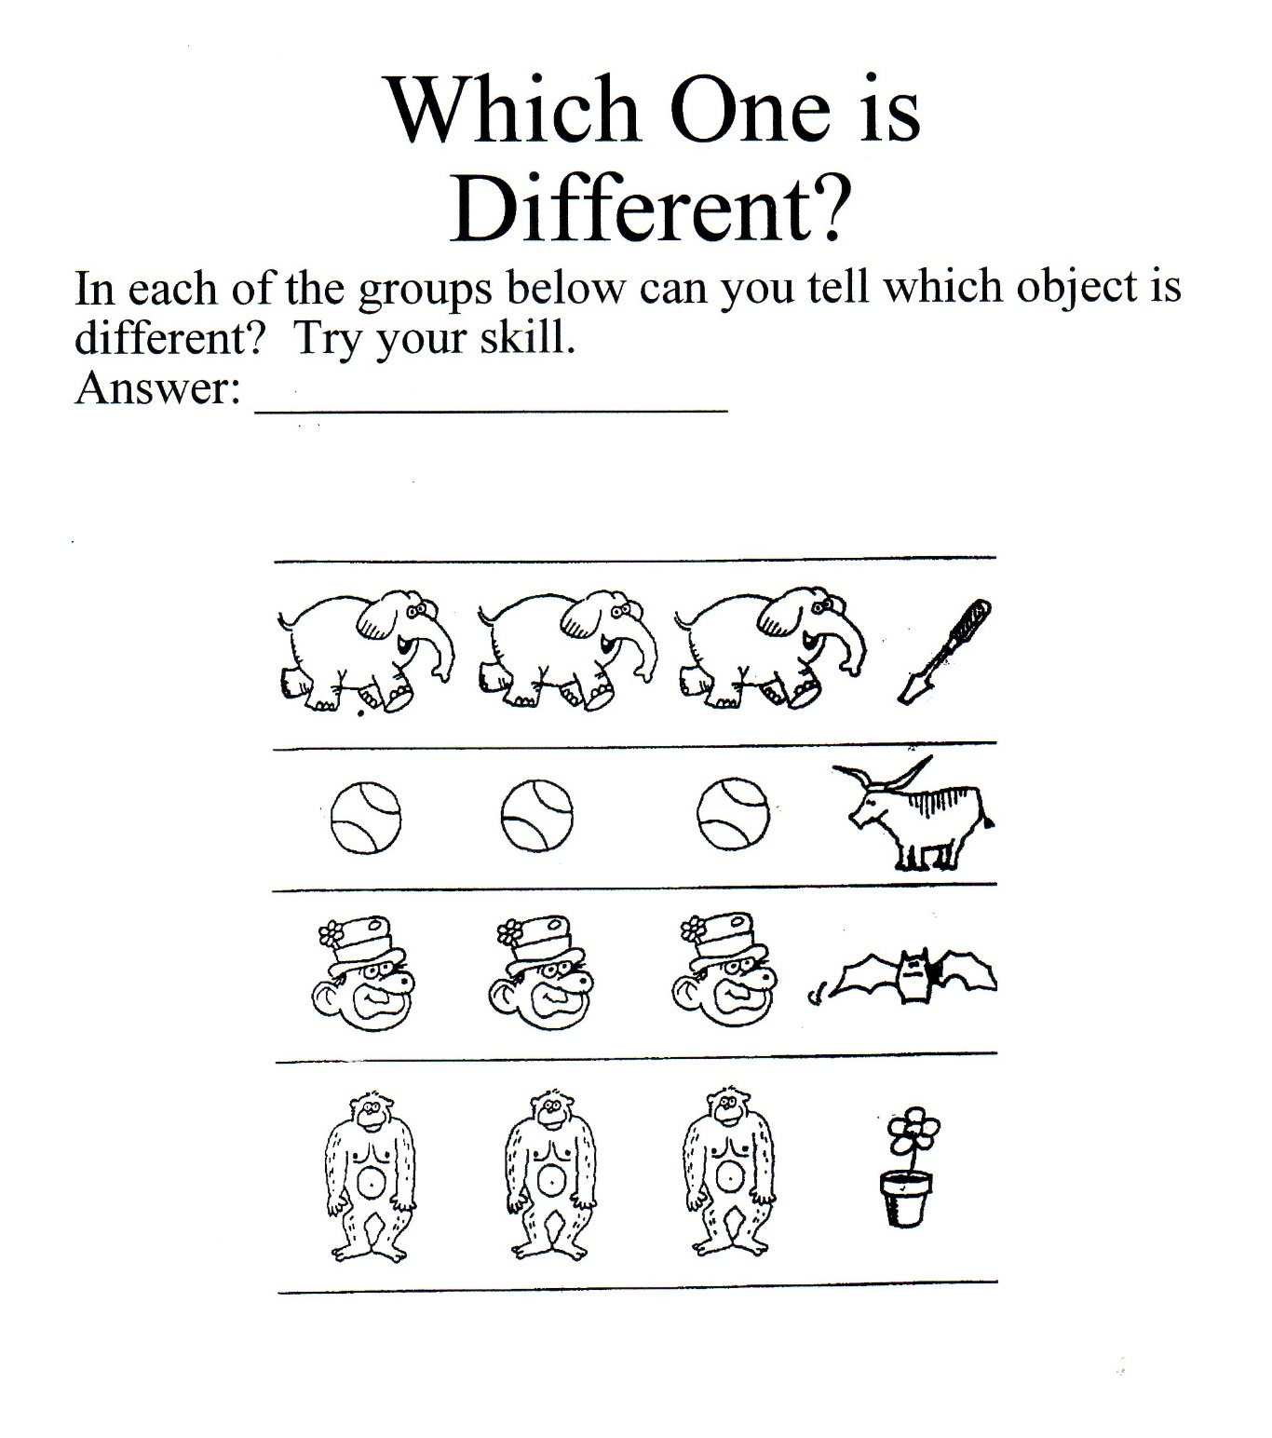
A B C D
Group 1
Group 2
Group 3
Group 4

Slide 7
Sports Quiz
In golf, what type of ball does one hit?
A. Beach Ball
B. Masquerade Ball
C. Golf Ball
D. Football

Slide 8
Which is BIGGER?
A. Watermelon B. Jelly Bean

Slide 9
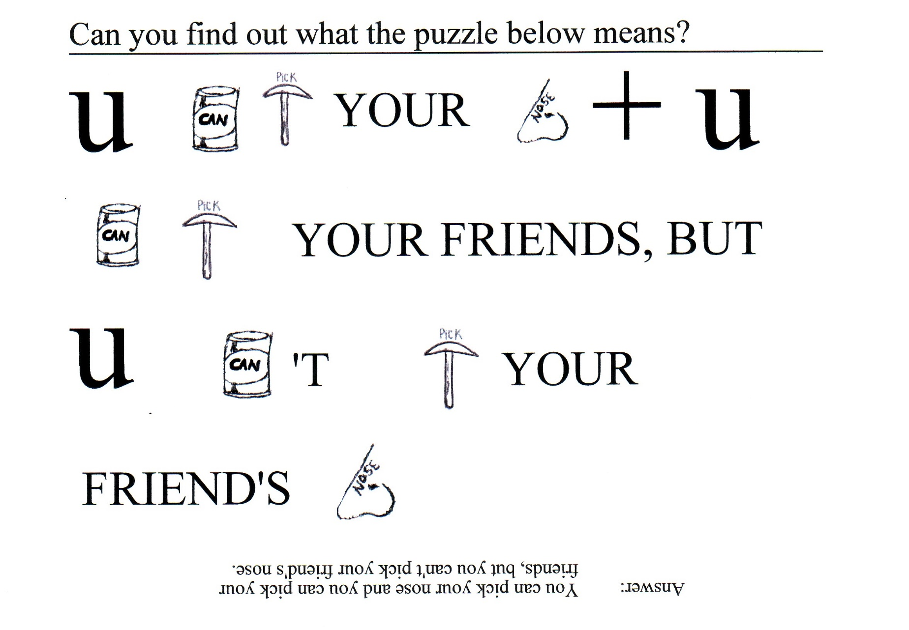
Bonus Question
Tell your neighbor the correct answer.

Slide 10
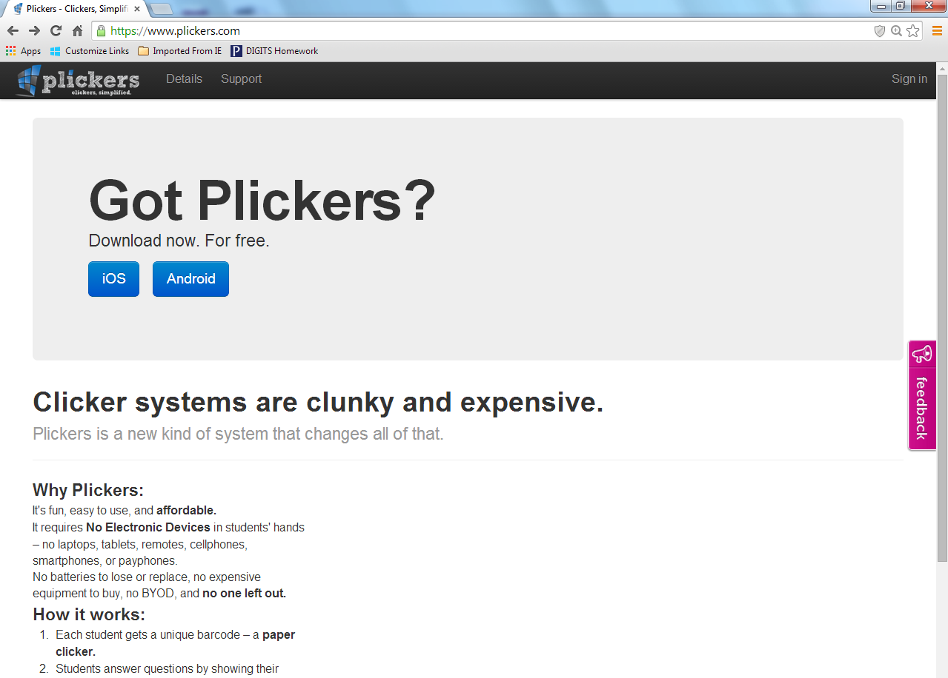
Plickers
In Chrome, go to www.plickers.com

Slide 11
Plickers
Download the App for your device (phone or tablet)

Slide 12
Plickers
Sign in

Slide 13
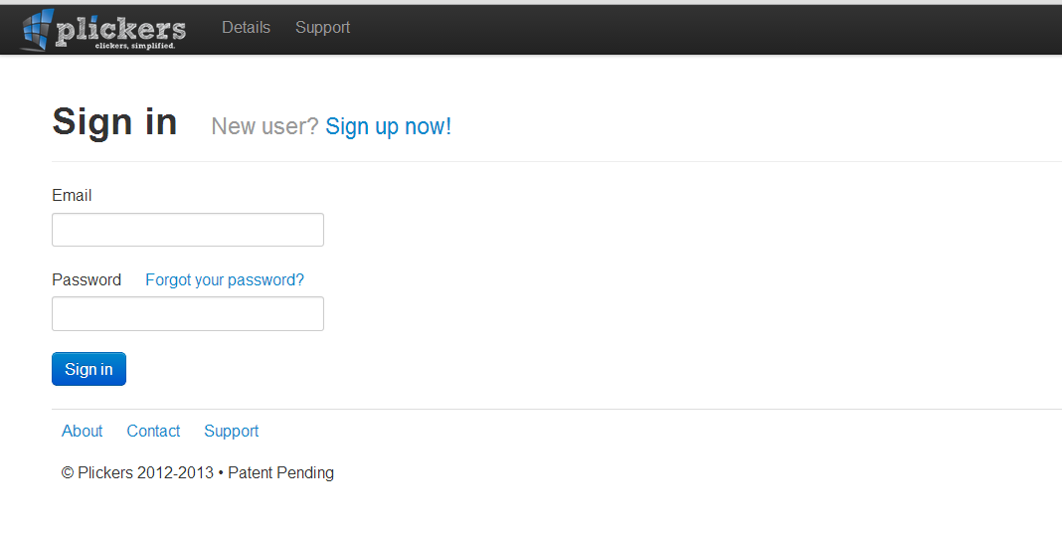
Plickers
Register for an account

Slide 14
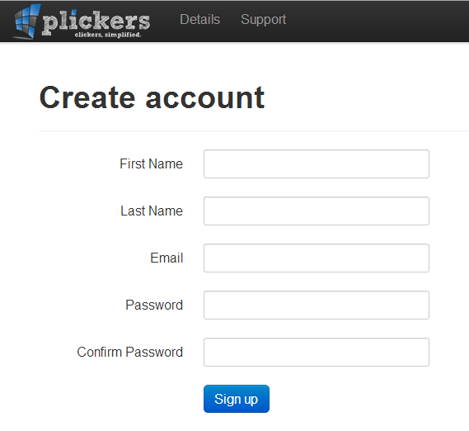
Plickers
Complete the form to create your account

Slide 15
Plickers
Sign in

Slide 16
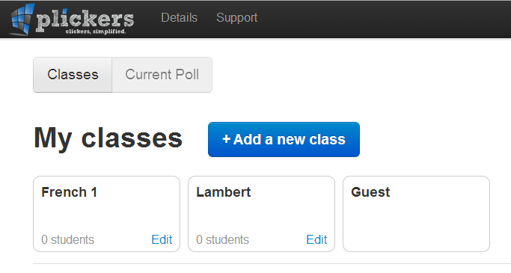
Plickers
On your desktop, computer set up your class

Slide 17
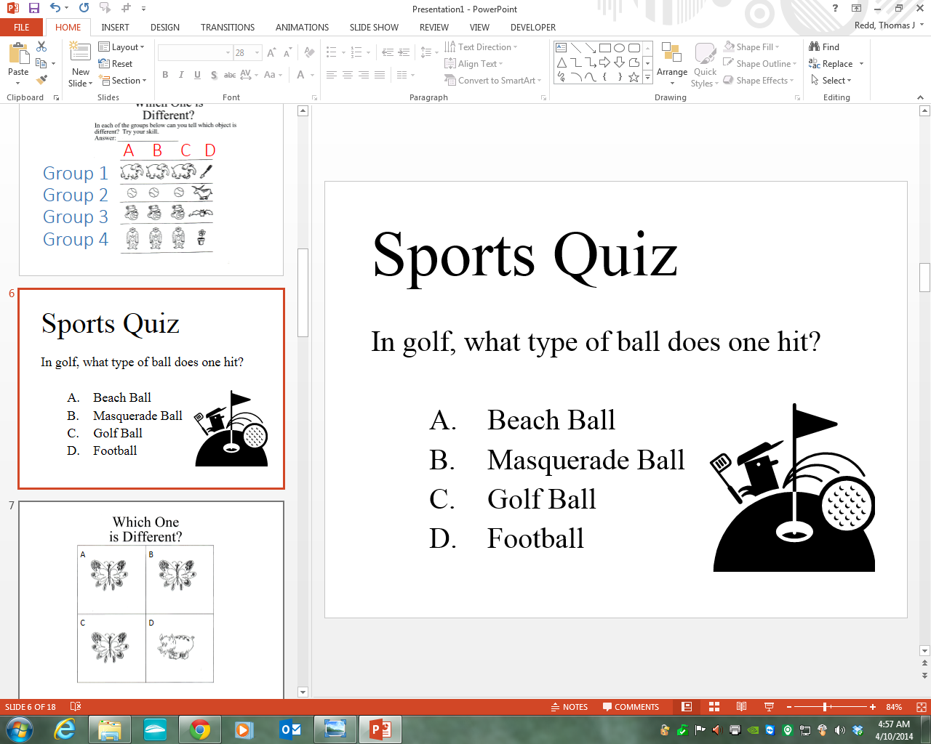
Plickers
Create questions (perhaps in PowerPoint for classroom projection)

Slide 18
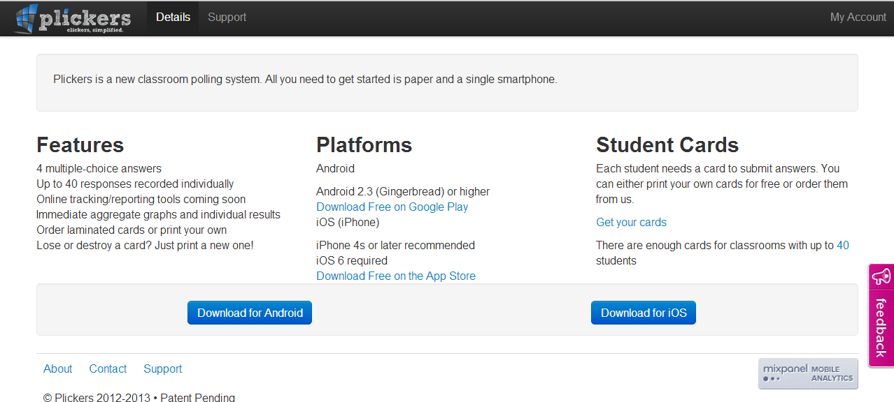
Plickers
Print student response cards from the website

Slide 19
Plickers
Print student response cards from the website

Slide 20
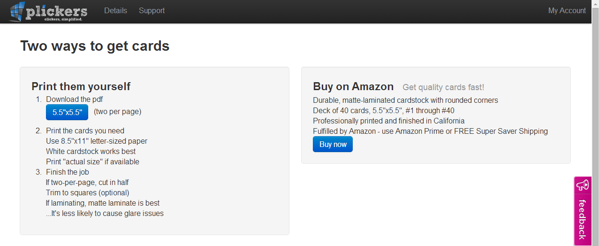
Plickers
Print student response cards from the website

Slide 21

Two Cards per page.
Usually scannable from 20-25ft.
Less likely to block other cards
Prints 2 cards per page

Slide 22
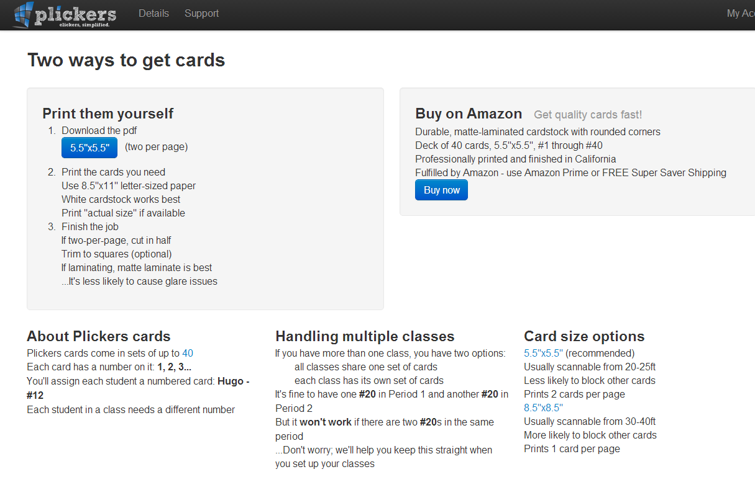
Larger cards available

Slide 23

One Card per page.
Usually scannable from 30-40ft
More likely to block other cards
Prints 1 card per page

Slide 24
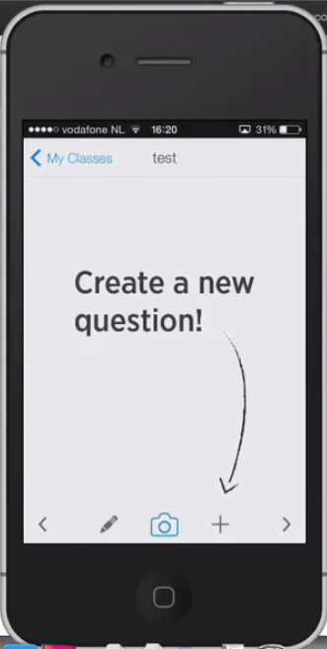
Plickers
Setup questions on your device

Slide 25
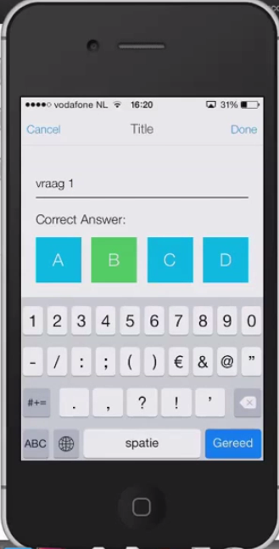
Plickers
Setup questions on your device

Slide 26
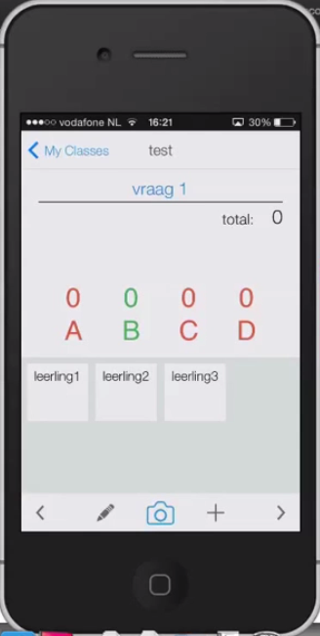
Plickers
Tap the camera image

Slide 27
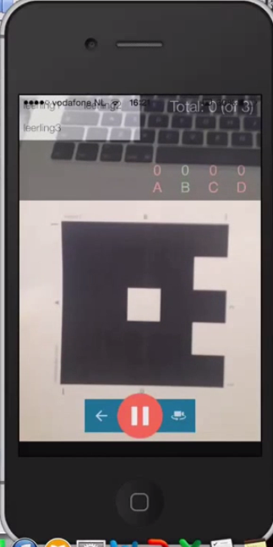
Plickers
Scan your students’ answers

Slide 28
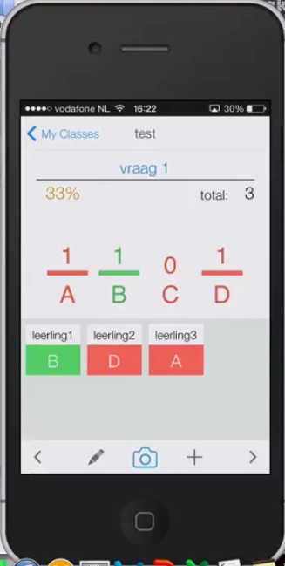
Plickers
View your students’ responses on your device

Slide 29
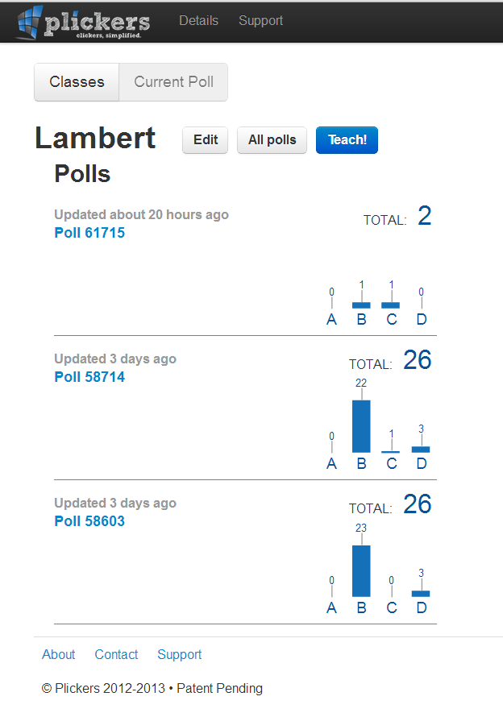
Plickers
Or on your Desktop

