Slide 1
Team Viewer
October 31, 2014

Slide 2
Overview Video

Slide 3
Download and install on your Computer
Go to Teamviewer.com
Download
Run and install
Be sure to check the Free for personal use box as you install
Create your Team Viewer account

Slide 4
Create a password for each device
Enter the Personal Password information
Create your Team Viewer account

Slide 5
App for your iPad
Go to the App Store
Search TeamViewer Remote
Install
Be sure to check the Free for personal use box as you install
Use your Team Viewer account information on all devices

Slide 6
Additional Computing Devices
You may add all your computing devices
Be sure to use your Team Viewer account information for all your additional devices
Enter Passwords for each device
You may use the same password for each device

Slide 7
Using your account
Open the Computers and Contacts button
Complete the login for your account
Click on any computer in the top of the window
You will connected to your remote Computer

Slide 8
Reaching your iPad remotely
Install TeamViewer QuickSupport to control your iPad with your computer

Slide 10
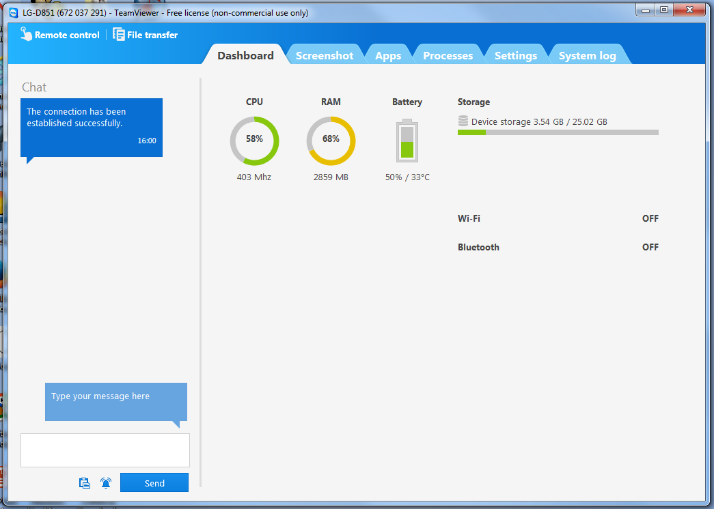
This is your Desktop screen

Slide 11
Click Remote Control in top left corner

Slide 12
Allow control on your device Remote control the device from the desktop

Slide 13
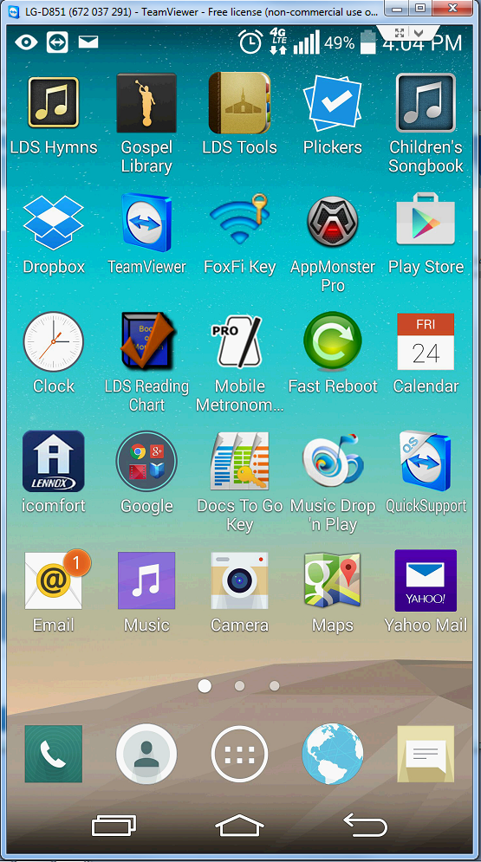
Allow control on your device Remote control the device from the desktop

Slide 14
More information:
www.teamviewer.com
http://tomshelppages.weebly.com/team-viewer.html

