Slide 1
Using Your Phone
Training PowerPoint

Slide 2
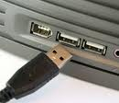
Connecting Your Phone
Just plug into the USB port on your computer. You will find USB ports on the front or back of your computer.
If you have a laptop the ports are on the side or back of the computer.

Slide 3
Phone Used Office Commnicator
Office Communicator is the software that controls your phone
Be sure Office Communicator is installed correctly

Slide 4
What is Communicator?
It is instant messaging software.
It is the program that the phones will use to make calls.
You can use it to type messages to others, send files, or call other people.

Slide 5
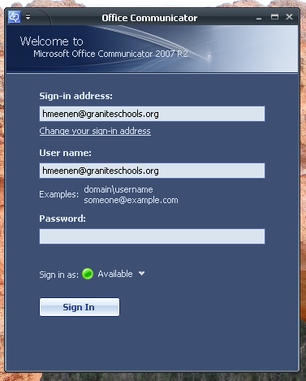
Signing in to Communicator
Check that the user name is your email address.
Your password is the same as your email password.
(Note: This should happen automatically when you log in.)

Slide 6

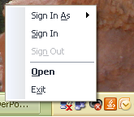
Where is the Communicator Icon
If you look in the lower right side of your computer screen you will find the communicator icon.
It is green if you are signed in and gray with a red x if you are signed out.
If you click on the icon it will open a window that will allow you to select a task. Click open to see contacts.

Slide 7
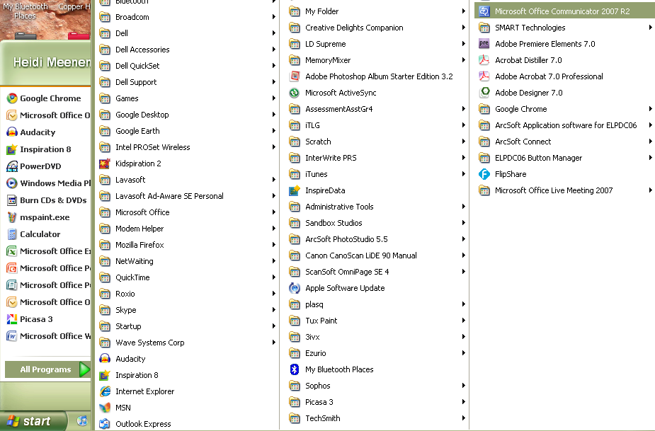
What if I can’t find the icon in the sys tray?
Go to Start.
Then All Programs.
Then look for Microsoft Office Communicator

Slide 8
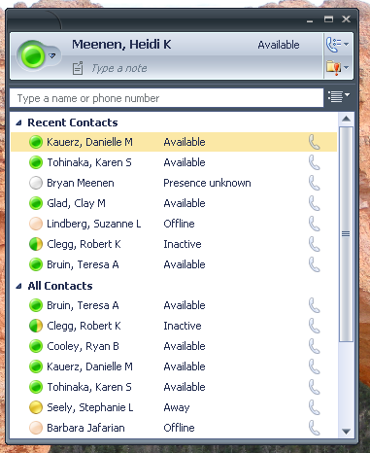
The Look of Communicator
When you open communicator you will see your list of contacts. A green circle means the person is available.
To find someone just begin typing their name.
People you contact often you will want to put in your All Contacts.

Slide 9
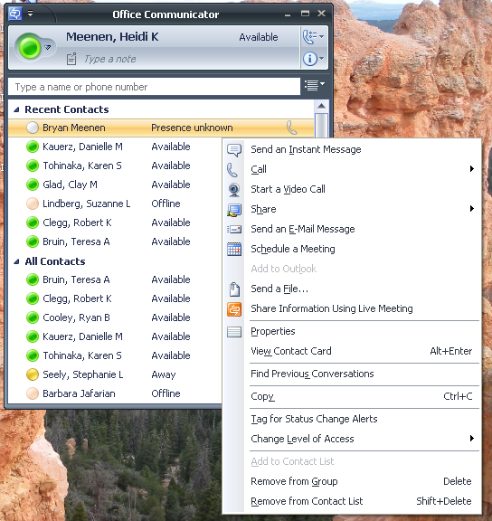
Other Options
Right click on the person’s name for more options.

Slide 10
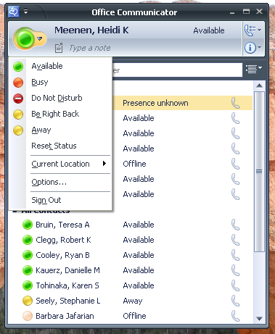
How to Set Your Status
Click on the down arrow by the colored circle by your name.
Then set your status.

Slide 11
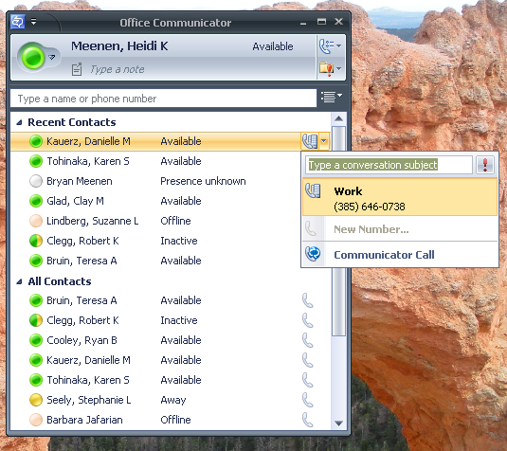
To Find a Phone Number
To find someone’s phone number just click on the drop down next to the phone icon.
Then click on communicator call.

Slide 12
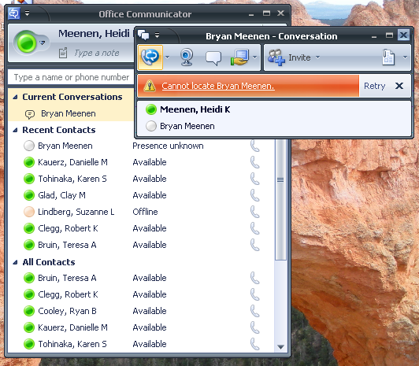
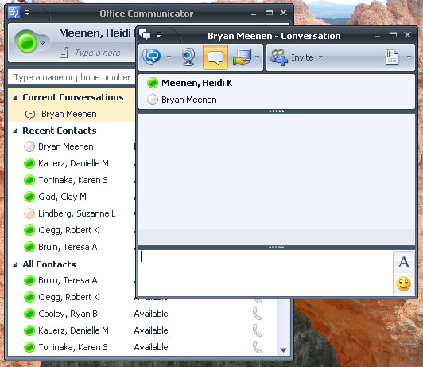
Options within the Conversation Window
You can see the status of your call.
Or you can send an instant message.

Slide 13
Final Items
If you set your status to busy or unavailable then the calls that come in will go to your email where you can listen to them.
You can call out just by dialing the number.
Remember: Do not call any school staff with regular phones (385-646-5061 numbers.) They cannot answer you.
  Jane, Tawni, Tom, Joni, Mindy, Kathy, etc.

Slide 14
For More Details…
To see details about many more Office Communicator options, go to this address:
http://db.tt/gzjeDWI
or check out the school website for the manual.

