Slide 1
Windows 10
What you need to know to get started

Slide 2
Things that have Changed in Windows 10 that you need to know :
Startup procedure
Where are your files?
Where is my Email?
Where is Word? (and other programs)
Locking program Icons to the Taskbar
Putting program Icons on the desktop
Single click to start programs from icons on the task bar
Logging off
Shutting down

Slide 3
the Startup sequence looks different (Not a big concern)

Slide 5
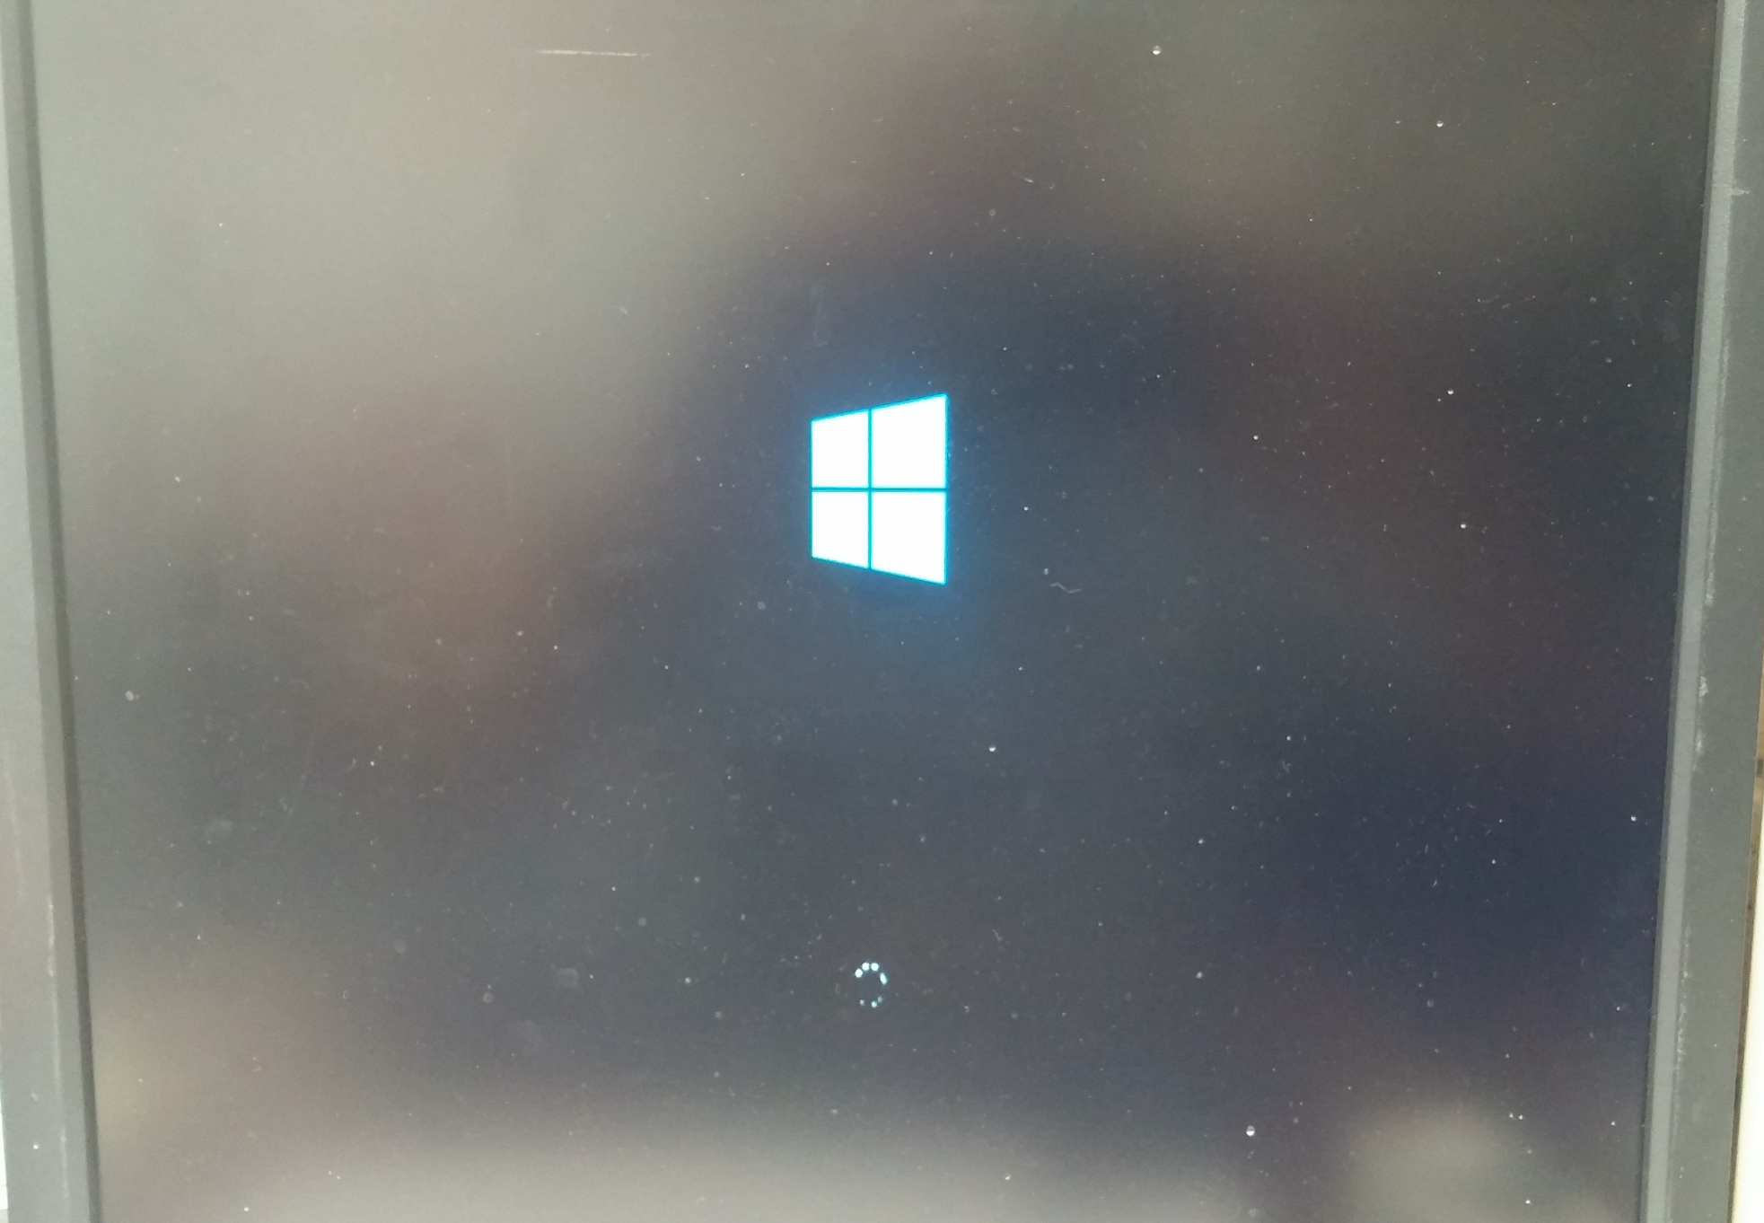

Slide 6
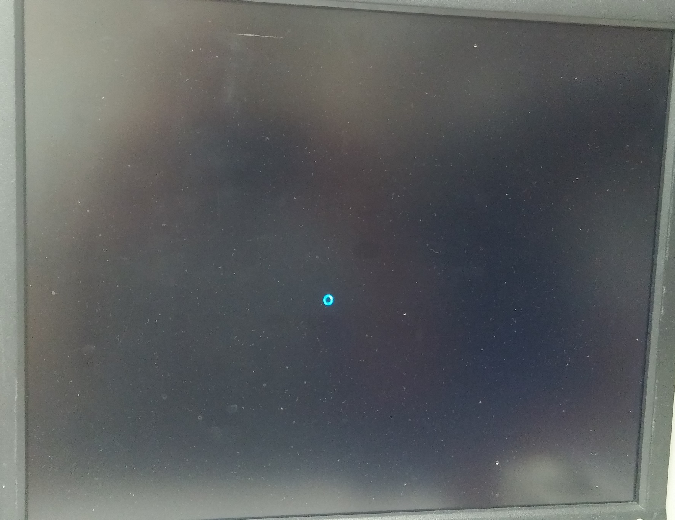

Slide 7
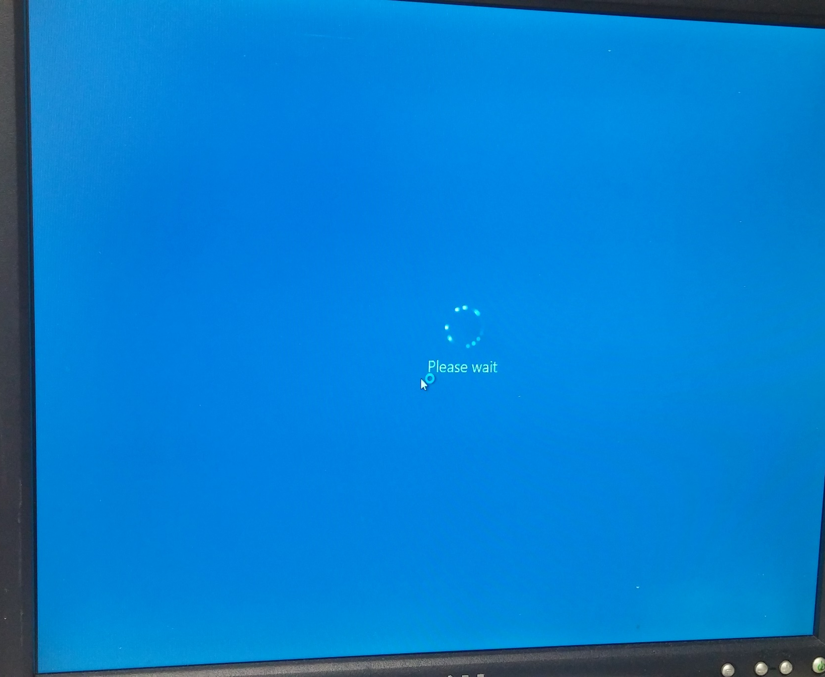

Slide 8
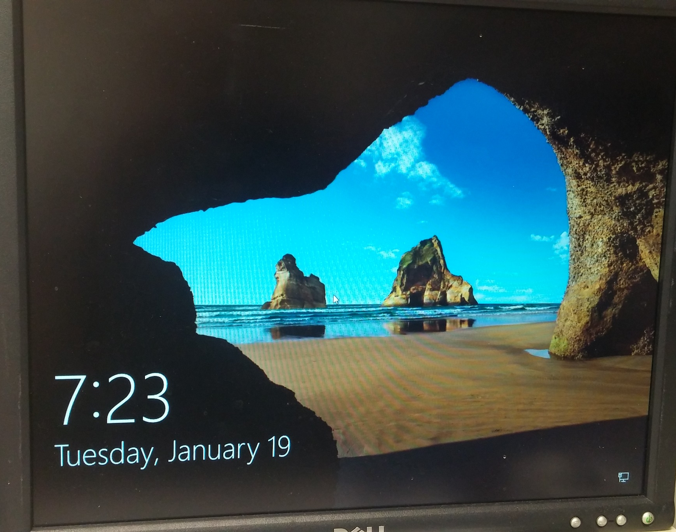

Slide 9
Click anywhere on this screen to get the log in screen

Slide 10
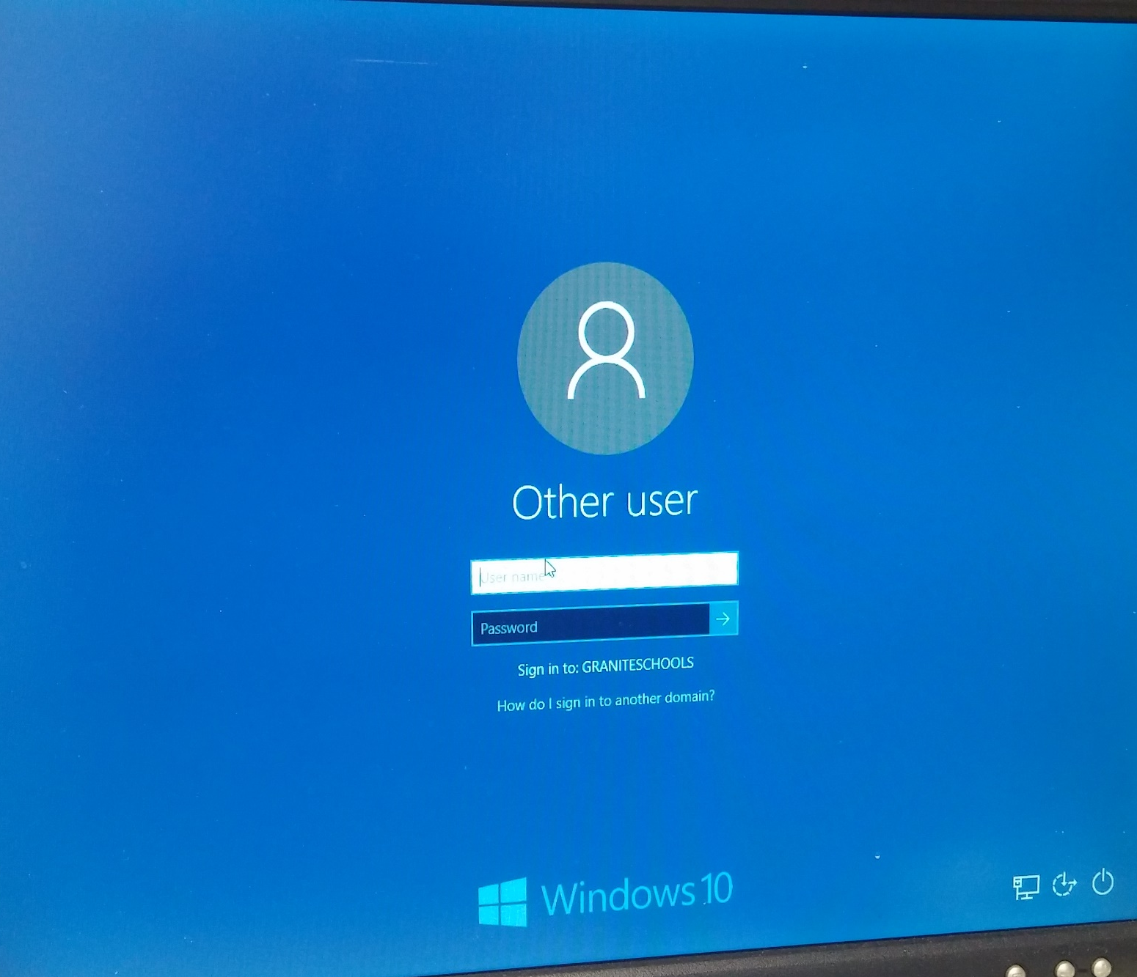
This works just like the log in screen in Windows 7 that you were used to.

Slide 11
The desktop looks similar, BUT…

Slide 12
The icons on Taskbar are missing

Slide 13
And where are my files?

Slide 14
Double Click the computer in the Top Left corner

Slide 15
Double click your “M” drive

Slide 16
There they are!

Slide 17
Make your files easy to find

Slide 18
Right Click the folder icon on the taskbar

Slide 19
Click Pin to Taskbar

Slide 20
It sticks even when you close the window!

Slide 21
Single click this folder to access your files

Slide 22
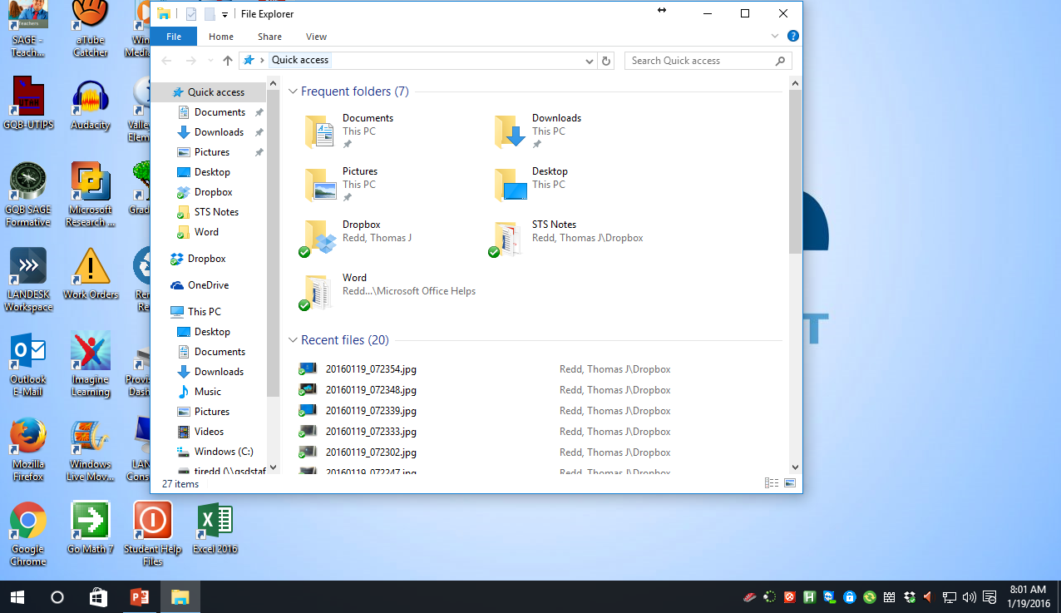
Double Click Documents (or pictures, etc.)

Slide 23
There are your files!

Slide 24
Where is my email?

Slide 25
Click the circle on the taskbar

Slide 26
Search bar shows

Slide 27
Type Outlook here

Slide 28
Click Outlook 2016

Slide 29
Double Click the Outlook icon

Slide 30
Complete the wizard and there are your emails

Slide 31
Pin Outlook to the taskbar for quick access

Slide 32
Right Click the icon

Slide 33
Click Pin to Taskbar

Slide 34
Outlook now sticks to the taskbar

Slide 35
In the future, simply Single Click this icon to quickly open Outlook

Slide 36
Where is Word?

Slide 37
Click the circle on the taskbar

Slide 38
Search bar shows

Slide 39
Type Word here

Slide 40
Click Word 2016 here

Slide 41
Word opens

Slide 42
Microsoft Office Suite 2016
Not in the handout
Minor changes in the User Interface (the look of the program)
Added “Tell me what you want to do…”
Added “Share”
Save file to cloud
Share with others by sending invitation
Some items renamed
Page Layout is now Layout
A few seldom used items moved to new locations
Same functionality

Slide 43
For quick access pin Word to the taskbar Right click icon at the bottom Click Pin to Taskbar

Slide 44
Find the other programs you use in the same way you found Word
1. Click the circle on the taskbar
2. Type the program name in the search box
3. Click the program name in the search results

Slide 45
Any open programs can be pinned to the taskbar in this same manner for quick access

Slide 46
Finding Internet Explorer
Not in the handout

Slide 47
Click the circle on the taskbar
Not in the handout

Slide 48
Search bar shows
Not in the handout

Slide 49
Type Internet here
Not in the handout

Slide 50
Click Internet Explorer
Not in the handout

Slide 51
Internet Explorer opens
Not in the handout

Slide 52
Send icons to the desktop

Slide 53
Click the circle on the taskbar

Slide 54
Search bar shows

Slide 55
Type the name of the program you want on your desktop in the search box. Example, type Word here

Slide 56
Right Click the program you found here

Slide 57
Click Open file location

Slide 58
When the folder opens, right click the grayed program name

Slide 59
Move over Send to and Click Desktop (create Shortcut)

Slide 60
The icon will appear on your desktop

Slide 61
In this same manner, you may add all the additional icons you wish

Slide 62
Starting programs from icons on the taskbar

Slide 63
Single click any icon on the taskbar to open the designated program

Slide 64
Logging off

Slide 65
Click the Start Button on the bottom left

Slide 66
Click Log off

Slide 67
To Switch Users, or another way to log off

Slide 68
Click the Start Button on the bottom left

Slide 69
Click your name at the top of the box

Slide 70
Click Sign out

Slide 71
Or Switch User

Slide 72
Or Lock your Screen

Slide 73
Shutting down your computer

Slide 74
Click the Start Button on the bottom left

Slide 75
Click Power

Slide 76
Click Shut down

Slide 77
That is enough information to get your started with Windows 10. Be sure to ask for help when you need it.

